Slide 1



PEGATRON GROUP
Introduction
Product & Solution
MAY, 2023
Download Brochure

Slide 2

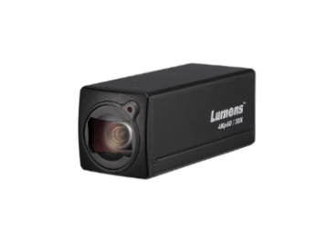
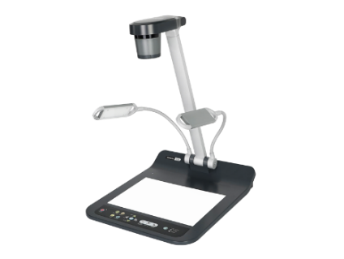
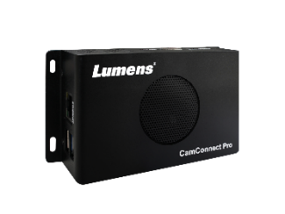
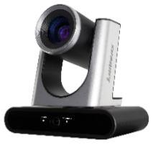
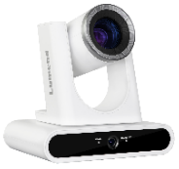
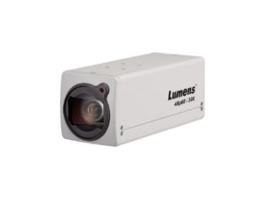
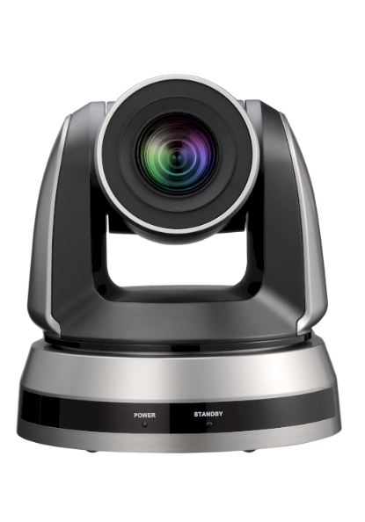

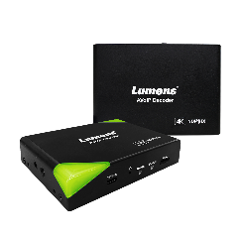
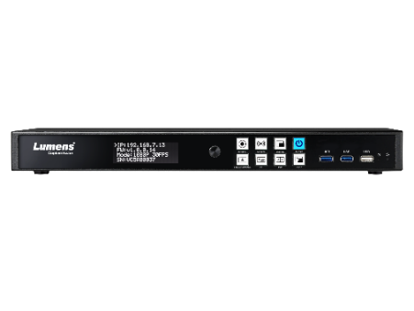
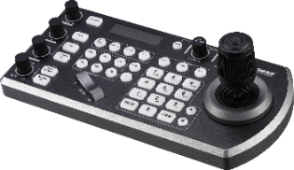
Product Line
Auto-Tracking
Camera
Box
Camera
Document Camera
CamConnect
Camera Controller
PTZ Camera
Media Processor
AV over IP

Slide 3



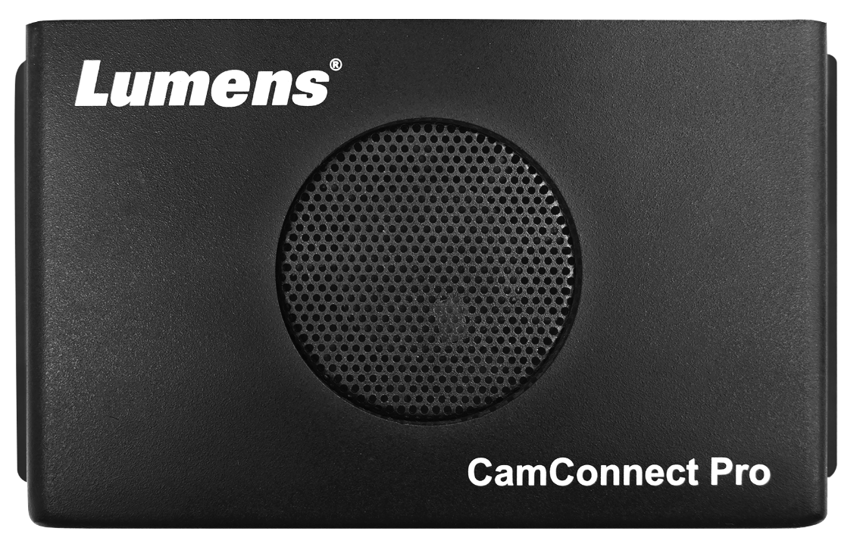

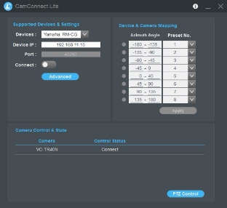




CamConnectTM
Synchronize your Mics and Cameras
CamConnect Lite is a complimentary software application which integrates Lumens PTZ camera control with a range of microphone array systems.
CamConnectTM Pro is new generation technology from Lumens, designed to enhance the UC experience. CamConnectTM Pro dynamically transforms the dial-in experience for remote meeting guests, external conference delegates and students engaged in distance learning.
CamConnect Lite
CamConnect Software
CamConnect Processor
AI-Box1

Slide 4
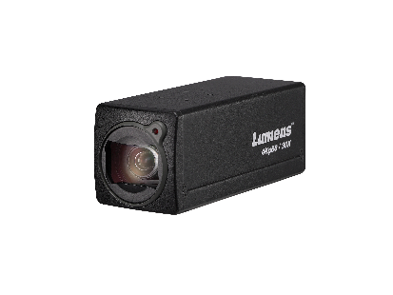
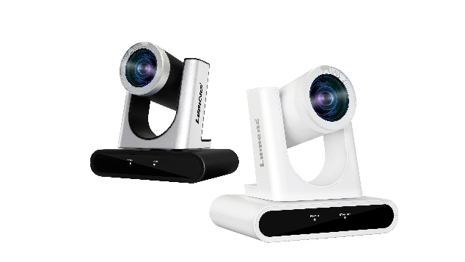
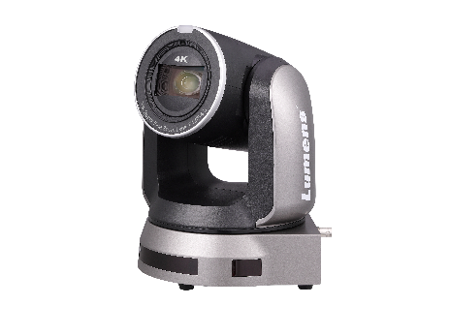
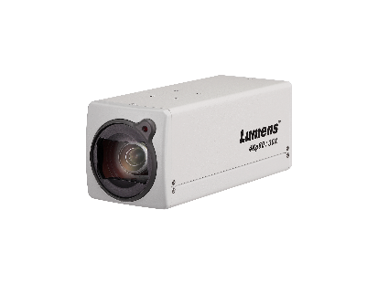
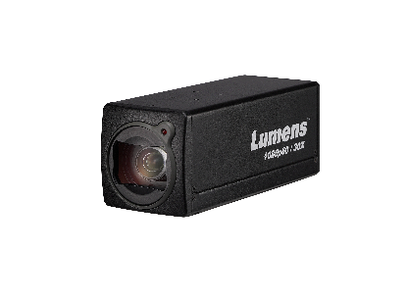
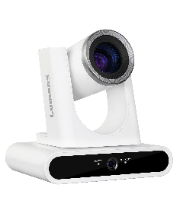
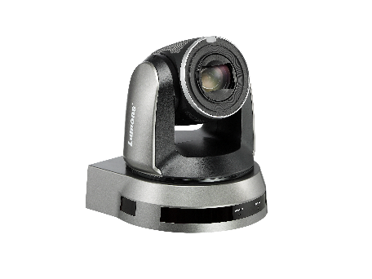
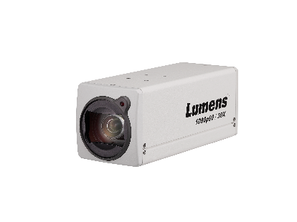
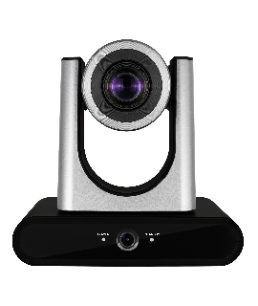
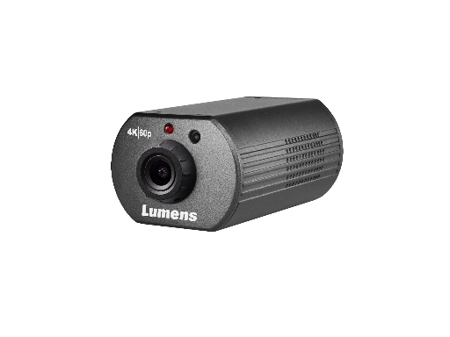
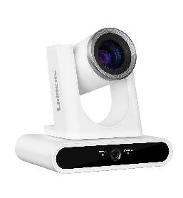

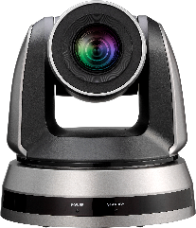
Auto-Tracking Camera
PTZ Camera
Box Camera
New!
VC-BC701P
VC-TR60
VC-A71P
4KP60 / 12X / 3G-SDI, HDMI, IP, USB
4KP60 / 30X / 12G-SDI, HDMI, IP, USB
4Kp60 / 30X / HDMI, IP
VC-BC601P
VC-TR40
VC-A61P
1080p30 / 30X / 3G-SDI, HDMI, IP
1080P60 / 20X / 3G-SDI, HDMI, IP, USB
4KP30 / 35X / 3G-SDI, HDMI, IP
New!
VC-TR30
VC-A51P
VC-BC301P
1080P60 / 12X / HDMI, USB, IP
1080P60 / 20X / 3G-SDI, HDMI, IP
4Kp60 / 12X / USB, HDMI, IP

Slide 5
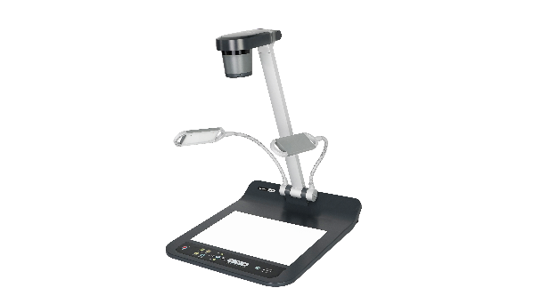
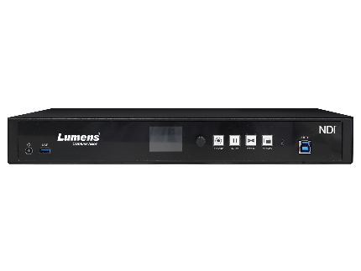
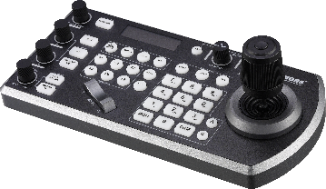
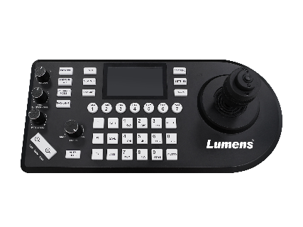
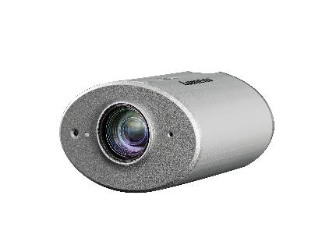
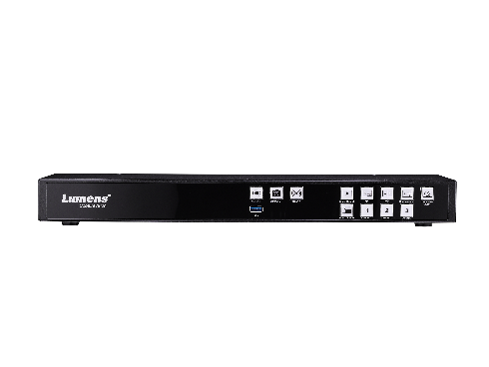
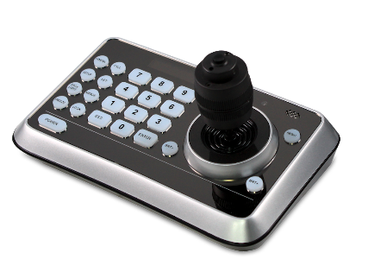
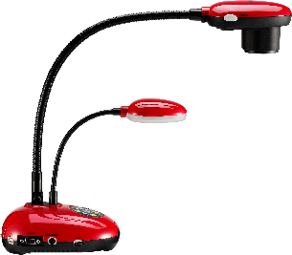
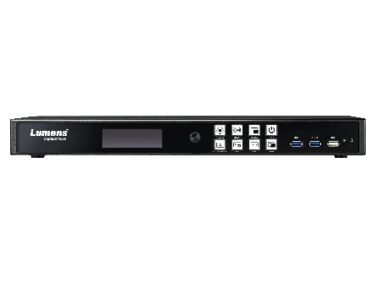
Camera Controller
Document Camera
Media Processor
VS-KB30
PS753
New!
LC300
IP Camera Controller with Joystick
Desktop, 4K / 300x / HDMI, USB, VGA, IP
4-CH / 4K Recording & Streaming / HDMI, SDI, IP, XLR Inputs
VS-KB21
CL511
LC200
IP, NDI Camera Controller with Joystick / Preview screen
Ceiling, 4K / 300x / HDMI, USB, VGA, IP
4-CH / HD Recording & Streaming / HDMI, IP Inputs
VS-K20
DC193
LC100
RS-232 & RS-422 Camera Controller with Joystick
Portable, 1080P / 10x / HDMI, USB
2-CH / HD Recording & Streaming / HDMI, SDI, IP, XLR Inputs

Slide 6
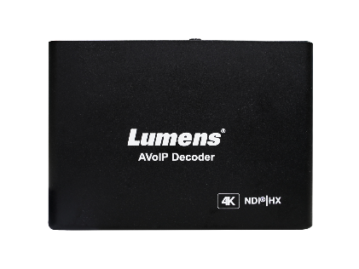
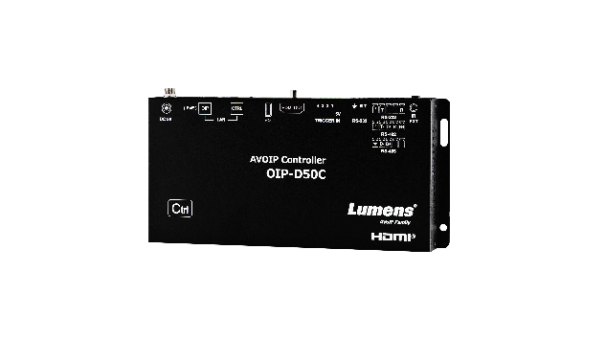
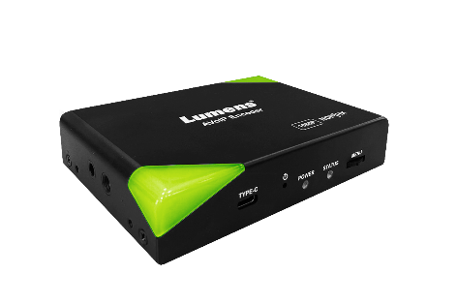
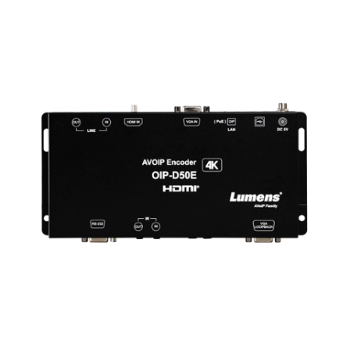
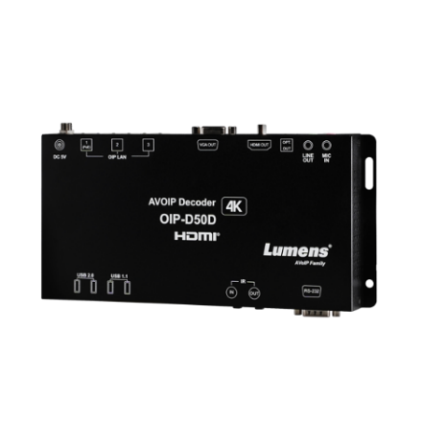
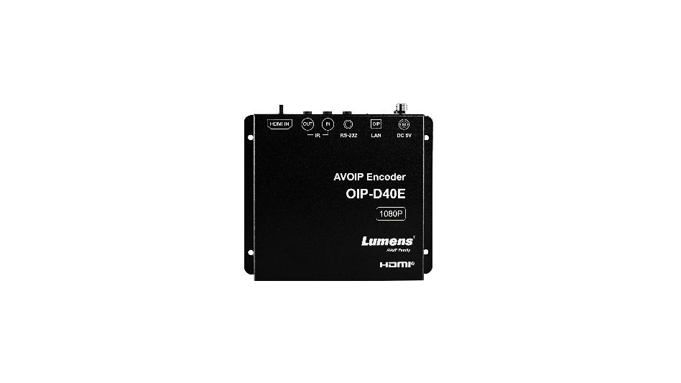
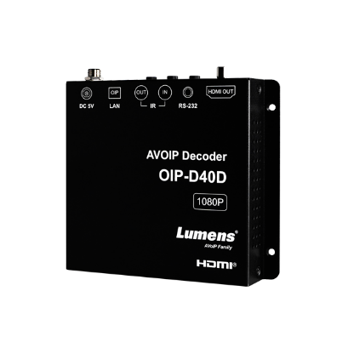
AV over IP
New!
New!
OIP-D50C
OIP-N40E
OIP-N60D
NDI 1080p60 Encoder
4K60 Decoder
Controller
OIP-D50E
OIP-D50D
1G 4K30 Encoder
1G 4K30 Decoder
OIP-D40E
OIP-D40D
1G 1080p60 Encoder
1G 1080p60 Decoder

Slide 7


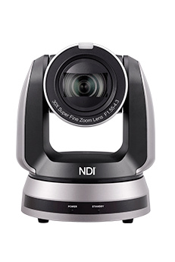





Auto-Tracking Camera
AV over IP
PTZ Camera
AV over IP
Media Processor
New!
New!
OIP-N60D Dante AV-H
4K60 Decoder
VC-TR61N
4KP60 / 25X / 3G-SDI, HDMI, IP, USB
VC-A71P-HN
4KP60 / 30X / 12G-SDI, HDMI, NDI|HX3, NDI|HB, USB
OIP-N60D
4K60 Decoder
LC300
4-CH / 4K Recording & Streaming /HDMI,3G-SDI,IP,XLR Inputs
VC-TR40N
1080P60 / 20X / HDMI, SDI, USB, IP
New!
VC-A71SN
4KP60 / 30X / 12G-SDI, HDMI, NDI|HX3, USB
OIP-N40E
1080p Encoder
LC300S
4-CH / 4K Recording & Streaming /HDMI, 12G-SDI, 3G-SDI, IP, XLR Inputs
Auto-Tracking
Camera
VC-A51PN
1080P60 / 20X / 3G-SDI, HDMI, NDI|HX, USB
LC100N
2-CH / HD Recording & Streaming / HDMI, SDI, IP, XLR Inputs
VC-TR60 Dante AV-H
4KP60 / 12X / 3G-SDI, HDMI, IP, USB

Slide 8






Software for Management Tool
Deployment Tool 2.0
(2023-July)
Companion module
OBS Plug-in and Dockable Controller
Manage multiple media processors and IP cameras over your network.
Enable the Stream Deck to control various cameras and processors.
Allows users to control multiple Lumens IP cameras while using OBS broadcasting software.
Crestron Software Module Driver
Extron Software Module Driver
Q-SYS Plug-in
Let Crestron controller integrators can quickly integrate Lumens media processor and cameras.
Let Extron controller integrators can quickly integrate Lumens cameras.
Let Q-SYS integrators can quickly integrate Lumens media processor and cameras.

Slide 9





Software for Camera Setting
Camera
Document Camera
CamConnect Lite
CamConnect Lite+
(2023-December)
Camera Controller
(2023-July)
Ladibug 3.5
Ladibug 3.0
Win / Mac / Chrome OS
CamConnect Lite is a voice-activated tracking software which integrates Lumens PTZ camera control with a range of microphone array systems.
Free software that helps the camera operator to monitor and control the multiple cameras through IP and USB.
Ladibug 4K
Software for document camera, users can capture images or videos of documents or 3D objects and project them onto a screen or display in real-time. The software also provides various features such as annotation tools, image and video recording...etc.
Virtual Camera 2.0
(2023-July)
Lumens virtual camera software allows users to connect a Lumens IP camera to the host computer using Ethernet. Just attach a Lumens IP camera to the LAN using a standard network cable and it’s now ready for your video conferencing.

Slide 10
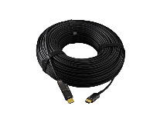
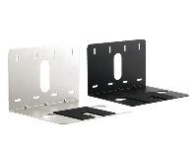
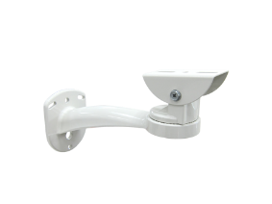
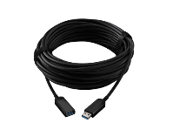
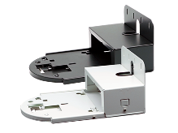
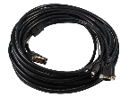
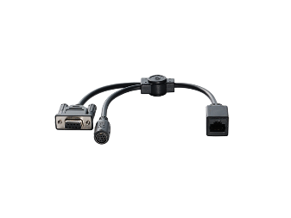
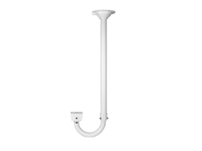
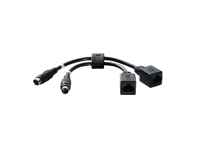


Accessory
Cable
Mount
CAB-AOCH-XL
HDMI 2.0 Active Extender Cable
VC-AC03
USB PTZ Camera Wall Mount
CAB-AOCU-ML
USB 3.1 Gen 1 Active Extender Cable
VC-WM11
Camera Wall Mount
VC-AC02
HDCI Cable
VC-WM12
PTZ Wall Mount
VC-WM13
J-type Ceiling Mount
VC-AC06
VISCA Cable Extender
VC-AC07
VISCA Cable Extender
VC-WM14
3-in-1 Multipurpose Mount
VC-WM15
J-type Ceiling Mount

Slide 11






Huddle Room
Solution
VC-B11U
VC-B2U
4K USB Auto Framing Camera
Full HD 90° FOV Webcam
MS-10
MS-EM1
4K Video Sound bar with Auto Framing
Extension Mic
MS-10S
4K Video Sound bar with Speaker Tracking

Slide 12





Medium Meeting Room Solution
VC-B30U
VC-R30
Full HD USB PTZ Camera
12x Optical zoom
Full HD IP&USB PTZ Camera
12x Optical Zoom
CamConnect Lite
AI-Box1
Voice-activated Tracking Software
CamConnect Processor

Slide 13




Large Meeting Room Solution
VC-A71P
OIP-D50E / OIP-D50D
4K 60fps, 30x IP PTZ Camera
1G Encoder & Decoder
VC-A51P
LC200
1080p 20x IP PTZ Camera
4 channel, 1080p recorder and
live streaming processor

Slide 14



Control Room
Solution
OIP-D50E / OIP-D50D
OIP-D50C
1G Encoder & Decoder
Controller
OIP-D40E / OIP-D40D
OIP-N40E / OIP-N60D
1G Encoder & Decoder
NDI|HX3 Encoder & Decoder

Slide 15


Hybrid Classroom Solution
VC-TR40
PS753
AI Auto-Tracking Camera
4K Desktop Document Camera
VC-R30
LC100
Full HD IP&USB PTZ Camera
2-CH / HD Recording & Streaming / HDMI, SDI, IP, XLR Inputs

Slide 16
www.MyLumens.com
We are open for cooperation
Lumens Digital Optics Inc.
Email: https://www.mylumens.com/en/Contact
Tel: +886-3552-6255
Address: No. 20, Taiyuan St., Zhubei City, Hsinchu County 302082, Taiwan

